Slide 1
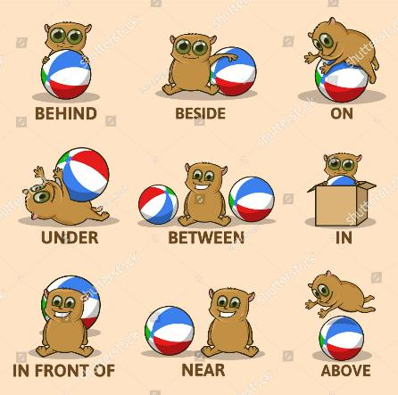
HOME UNIT 5
BOOK p. 86–90
WORKBOOK p. 84, 85, 89, 90

Slide 2
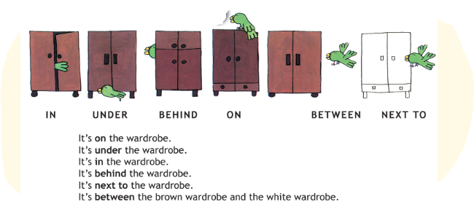
WHERE IS THE PARROT? Listen, read and point. Poslušaj, preberi in pokaži.
BOOK – p. 86

Slide 3
WHERE IS THE BALL? Write the words into your notebook. Prepiši besede v zvezek.
NOTEBOOK
IN – V
NEXT TO – POLEG
UNDER – POD
BEHIND – ZADAJ
ON – NA
BETWEEN – MED

Slide 4
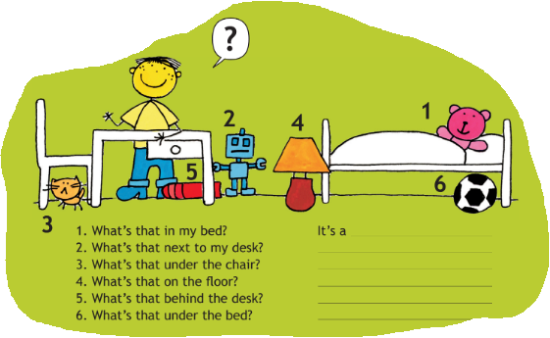
TIM‘S ROOM Write the answers into your notebook. Odgovore zapiši v zvezek.
BOOK – p. 87 + notebook

Slide 5
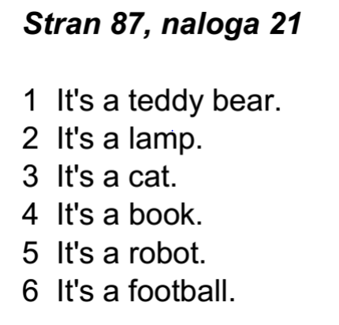
TIM‘S ROOM Check your answers. Preveri rešitve.
BOOK – p. 87 + notebook

Slide 6
THERE‘S A HOUSE IN THE YARD Listen and read. Poslušaj in preberi.
BOOK – p. 88

Slide 7
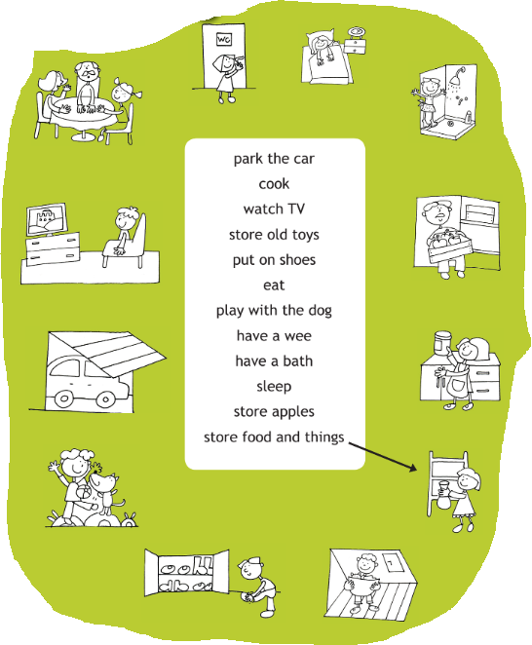
WHAT CAN YOU DO IN THE … ? Listen and write the answers into your notebook. Poslušaj in napiši odgovore v zvezek.
BOOK – p. 89 + notebook
What can you do in the …
pantry? ________________
kitchen? _______________
hall? ___________________
dining room? ___________
living room? ____________
bathroom? _____________
bedroom? _____________
garage? _______________
garden? _______________
attic? __________________
cellar? _________________
toilet? __________________

Slide 8
WHAT CAN YOU DO IN THE …? Check your answers. Preveri rešitve.
BOOK – p. 89 + notebook
What can you do in the …
pantry? Store food and things.
kitchen? Cook.
hall? Put on shoes.
dining room? Eat.
living room? Watch TV.
bathroom? Have a bath.
bedroom? Sleep.
garage? Park the car.
garden? Play with the dog.
attic? Store old toys.
cellar? Store apples.
toilet? Have a wee.
store – shraniti

Slide 9
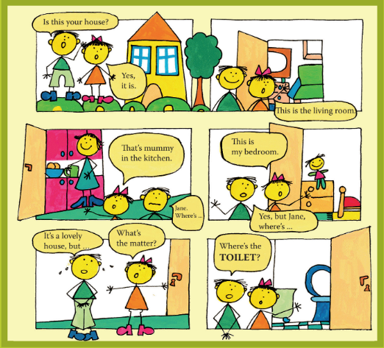
COME TO MY HOUSE Listen and read. Poslušaj in preberi.
BOOK – p. 90

Slide 10
BREAK
Play the video and do the workout. Predvajaj posnetek in telovadi.
Vir: https://www.youtube.com/watch?v=OkO8DaPIyXo

Slide 11
WORKBOOK – p. 84, 85, 89, 90
Open your workbook and do the exercises on pages 84, 85, 89 and 90.
Odpri delovni zvezek in naredi naloge na straneh 84, 85, 89 in 90.

Slide 12
Now check the answers in your workbook.

Slide 13
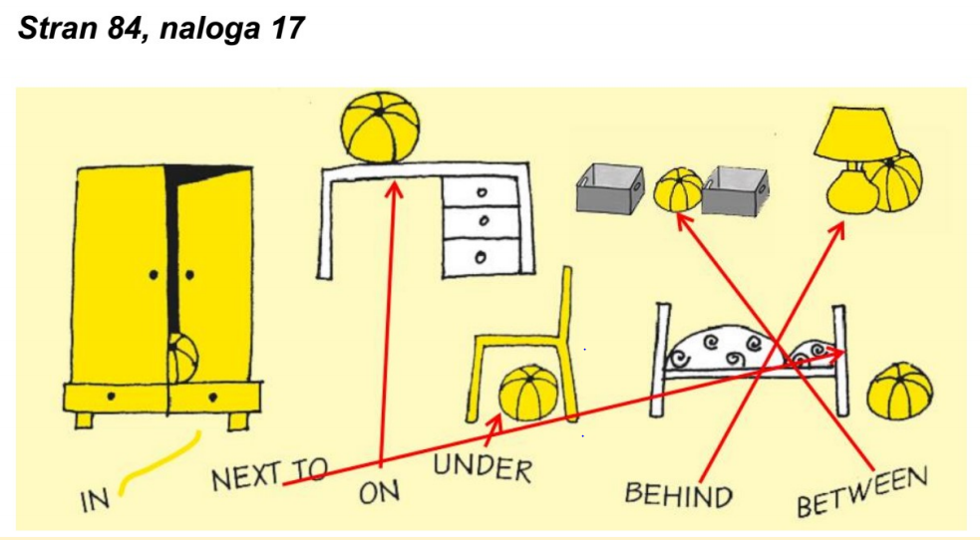
WORKBOOK – p. 84
Check the answers.
Preveri rešitve.

Slide 14
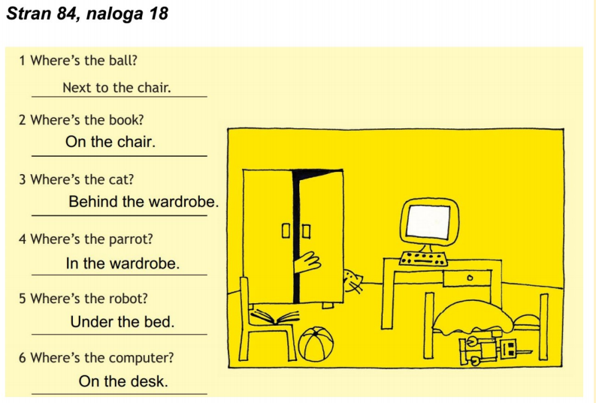
WORKBOOK – p. 84
Check the answers.
Preveri rešitve.

Slide 15
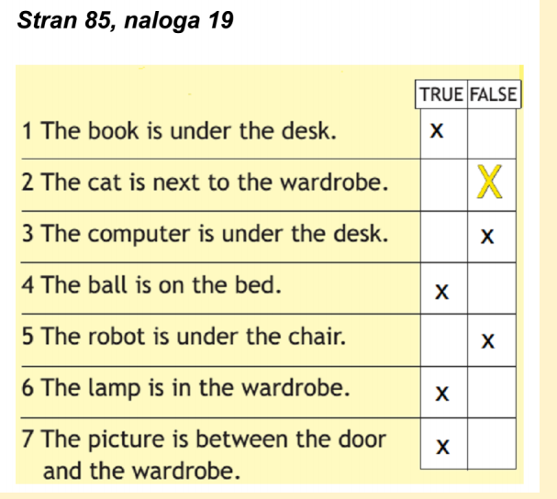
WORKBOOK – p. 85
Check the answers.
Preveri rešitve.

Slide 16
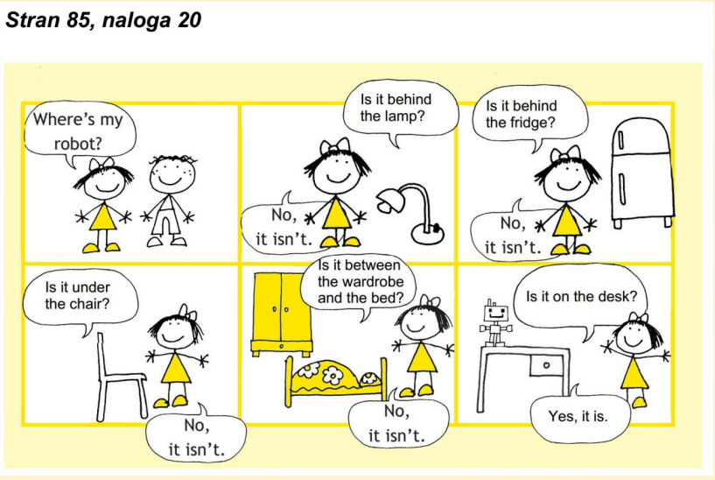
WORKBOOK – p. 85
Check the answers.
Preveri rešitve.

Slide 17
WORKBOOK – p. 89
Check the answers.
Preveri rešitve.

Slide 18
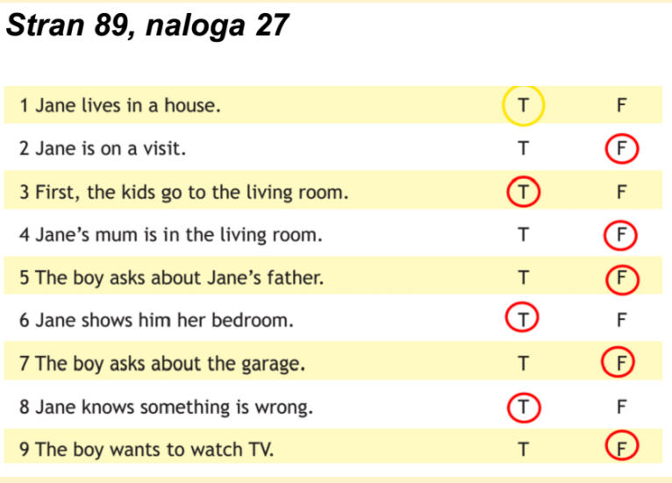
WORKBOOK – p. 89
Check the answers.
Preveri rešitve.

Slide 19
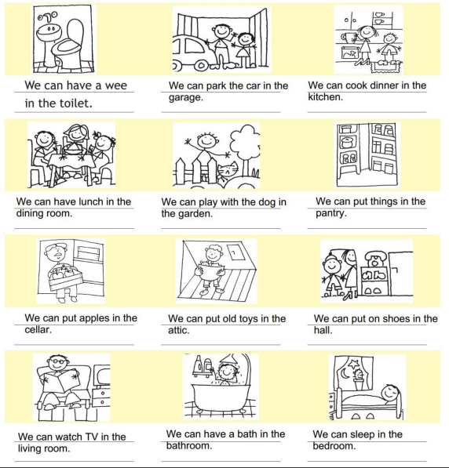
WORKBOOK – p. 90
Check the answers.
Preveri rešitve.

