Slide 1
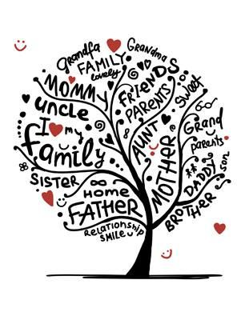
MEET MY FAMILY unit 4
Book page 61–63
Workbook page 58–63
Notebook

Slide 2
FAMILY TREE
BOOK – P. 61
LOOK AND ANSWER.
Poglej in ustno odgovori.

Slide 3
FAMILY TREE Družinsko drevo
BOOK – P. 61
CHECK THE ANSWERS.
Preveri rešitve.
This is me.
I am Helen‘s brother.
Twig is my bird.
Kitty is my cat.
Helen is my sister.
John is my father.
Lucy is my mother.
Mary is my grandmother.
Tony is my grandfather.
Tony and Mary are my grandparents.
Lucy and John are my parents.

Slide 4
BOOK – P. 62
LISTEN AND REPEAT.
Poslušaj in ponovi.

Slide 5
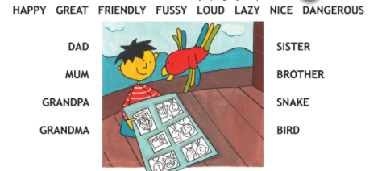
WHAT IS HE/SHE/IT LIKE? Kakšen/kakšna/kakšno je?
BOOK – P. 63
LISTEN.
Poslušaj.

Slide 6
WHAT IS HE/SHE/IT LIKE? Kakšen/kakšna/kakšno je?
BOOK – P. 63
Notebook
ANSWER INTO YOUR NOTEBOOK.
Odgovori v zvezek.
What is mum like?
What is dad like?
What is grandpa like?
What is grandma like?
What is sister like?
What is brother like?
What is snake like?
What is bird like?
Izbiraj med pridevniki:
happy
great
friendly
fussy – izbirčen
loud – glasen
lazy – len
nice
dangerous – nevaren

Slide 7
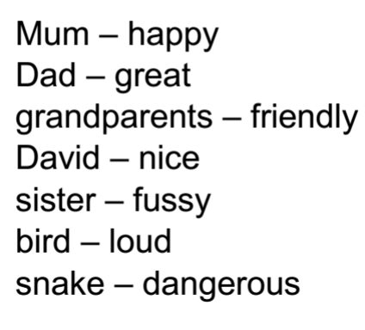
WHAT IS HE/SHE/IT LIKE? Kakšen/kakšna/kakšno je?
BOOK – P. 63
Notebook
CHECK THE ANSWERS.
Preveri rešitve.

Slide 8
BOOK – P. 63
LISTEN AND SAY.
Poslušaj in povej.

Slide 9
WORKBOOK – P. 58–63
DO THE EXERCISES ON PAGES 58–63.
Reši naloge na straneh 58–63.
Družinsko drevo na strani 60 nariši v zvezek.

Slide 10
Check the answers in your workbook.

Slide 12
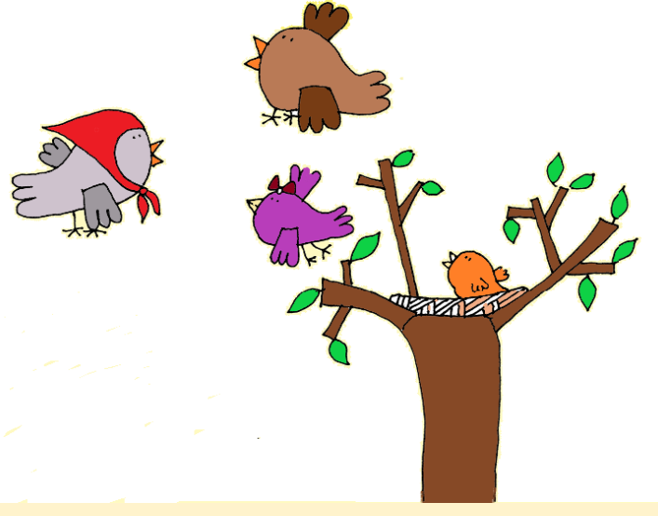
Stran 59, naloga 9 b

Slide 13
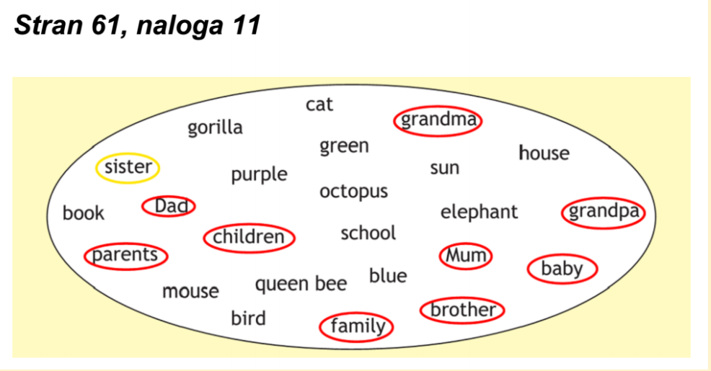

Slide 16
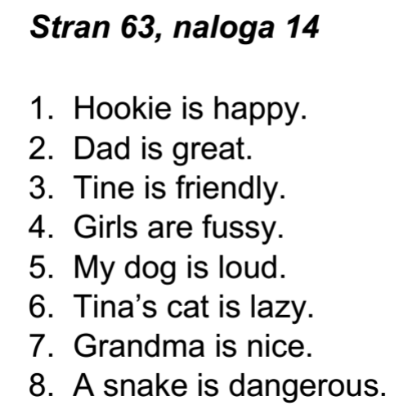

Slide 17
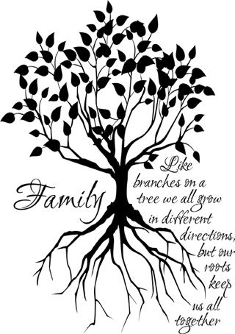
THAT IS ALL FOR THIS WEEK!
HAVE A NICE DAY,
GOODBYE!

